Slide 1
Time Series Momentum Trading Strategy
Group NO[O]NE
Menglin Shao Junhuan Zhu
Qingyuan Ren Ying Zhu Yongyi Zhao

Slide 2
Table of Content
Data Overview | 3
MACD Strategy | 4-7
Linear Regression Strategy | 7-9
XGBOOST Strategy | 10-12
LSTM Strategy | 13-15
HMM Strategy | 16-17

Slide 3
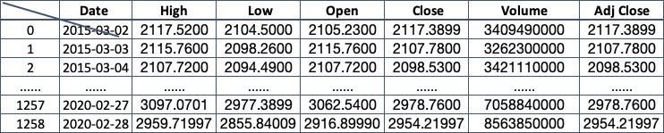
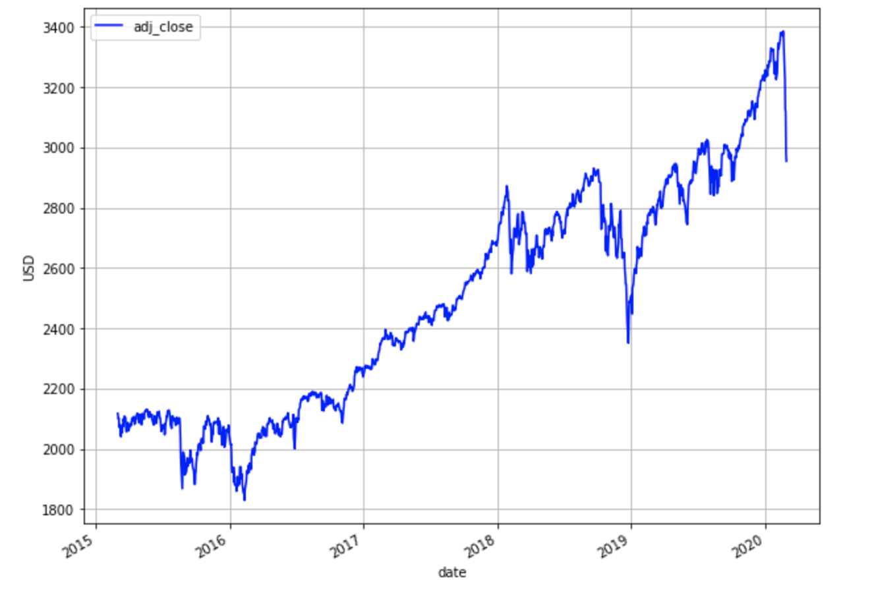
About The Data
We used S&P 500 Index (^GSPC) price from 2015-02-28 to 2020-02-28 which can be easily download from yahoo finance. All together, we have 1259 data to play with
pdr.get_data_yahoo('^GSPC',start = '2015-02-28', end = '2020-02-28')
A plot of the adjusted closing price in the entire dataset
We preprocessed data and add more features into it
‘range_hl‘ : difference between high and low
‘range_oc‘ : difference between open and close each day
‘adj_close_lag_1’, ‘adj_close_lag_2’, ‘adj_close_lag_3’, ‘range_hl_lag_1’, ‘range_hl_lag_2’, ‘range_hl_lag_3’,
‘range_oc_lag_1’, ‘range_oc_lag_2’, ‘range_oc_lag_3’,
‘volume_lag_1’, ‘volume_lag_2’, ‘volume_lag_3’,

Slide 4
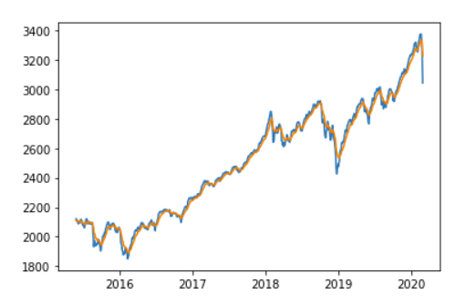
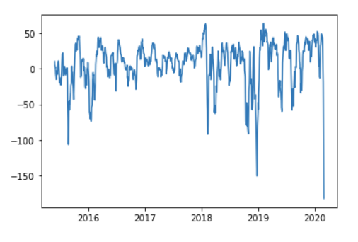
Moving Average Convergence Divergence
We use S&P 500 data to test our MACD strategy
1
EMA5 and EMA20
2
DIF

Slide 5
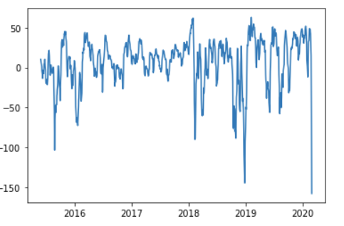
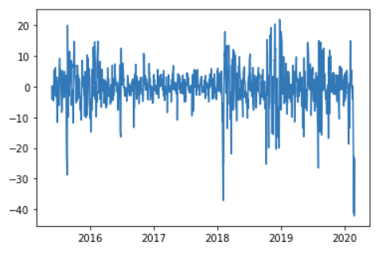
Moving Average Convergence Divergence
3
DEA
3
MACD

Slide 6
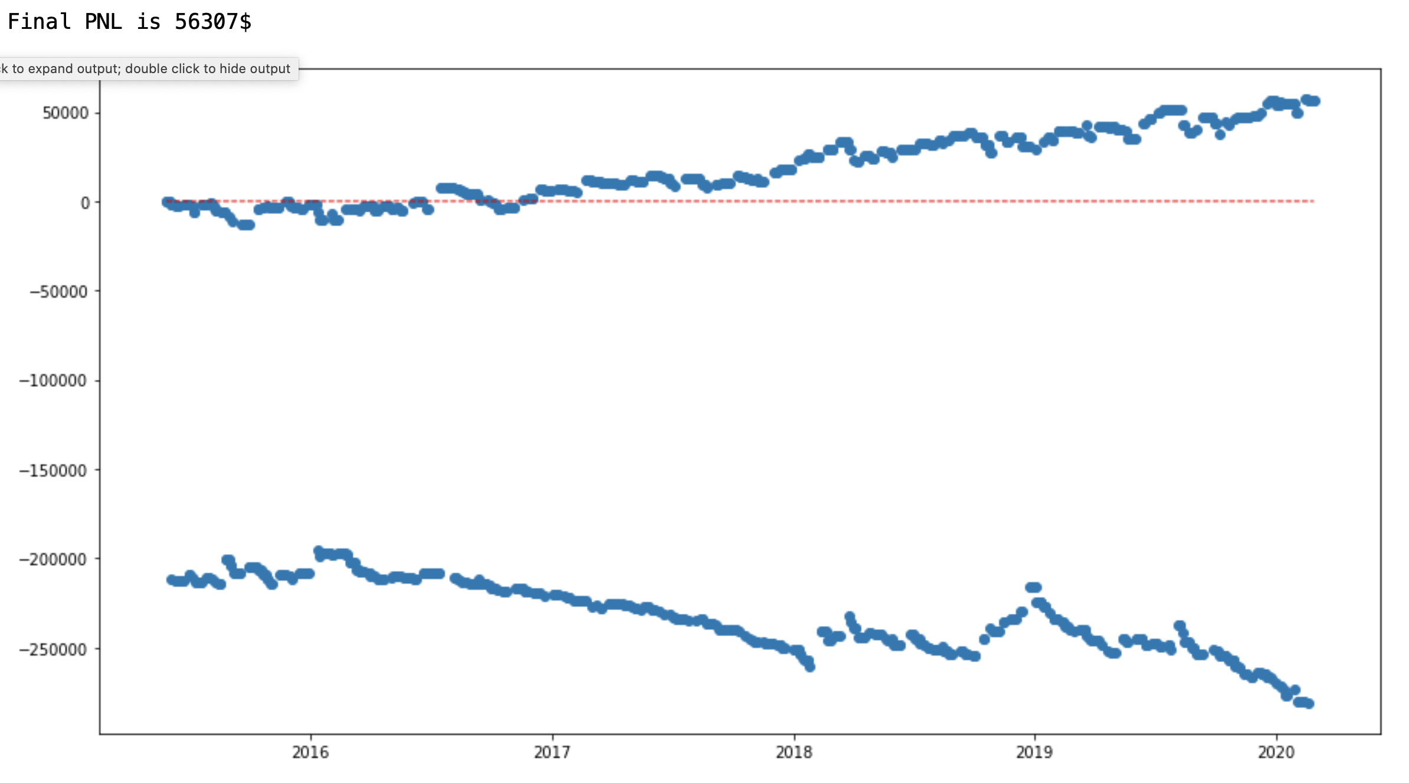
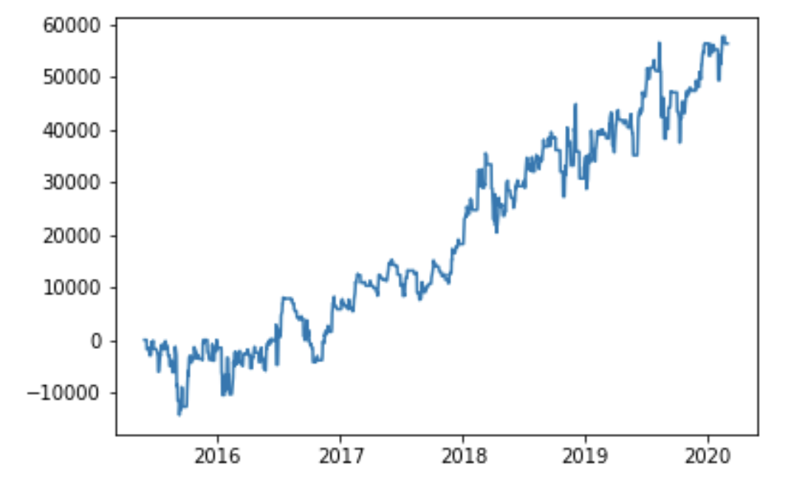
MACD Trading Strategy
Buy if MACD(t-1) < 0 and MACD(t) > 0, Sell if MACD(t-1)>0 and MACD(t) < 0
Profit and Loss Plot
Profit History Plot

Slide 7
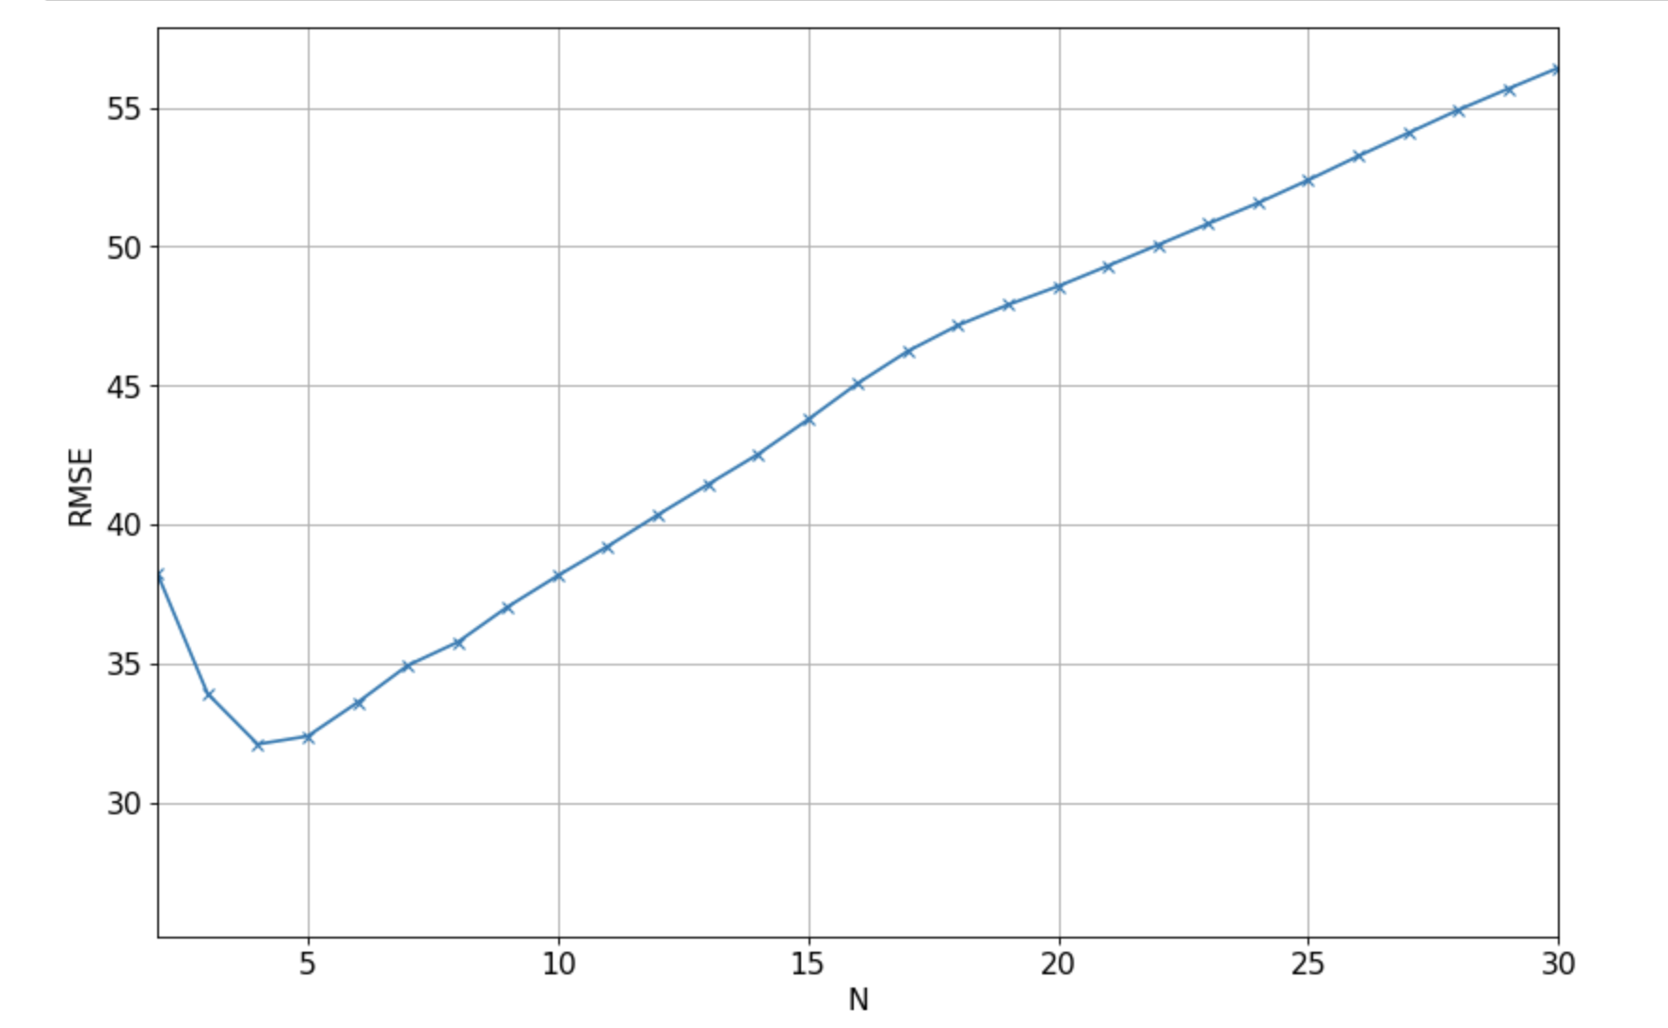
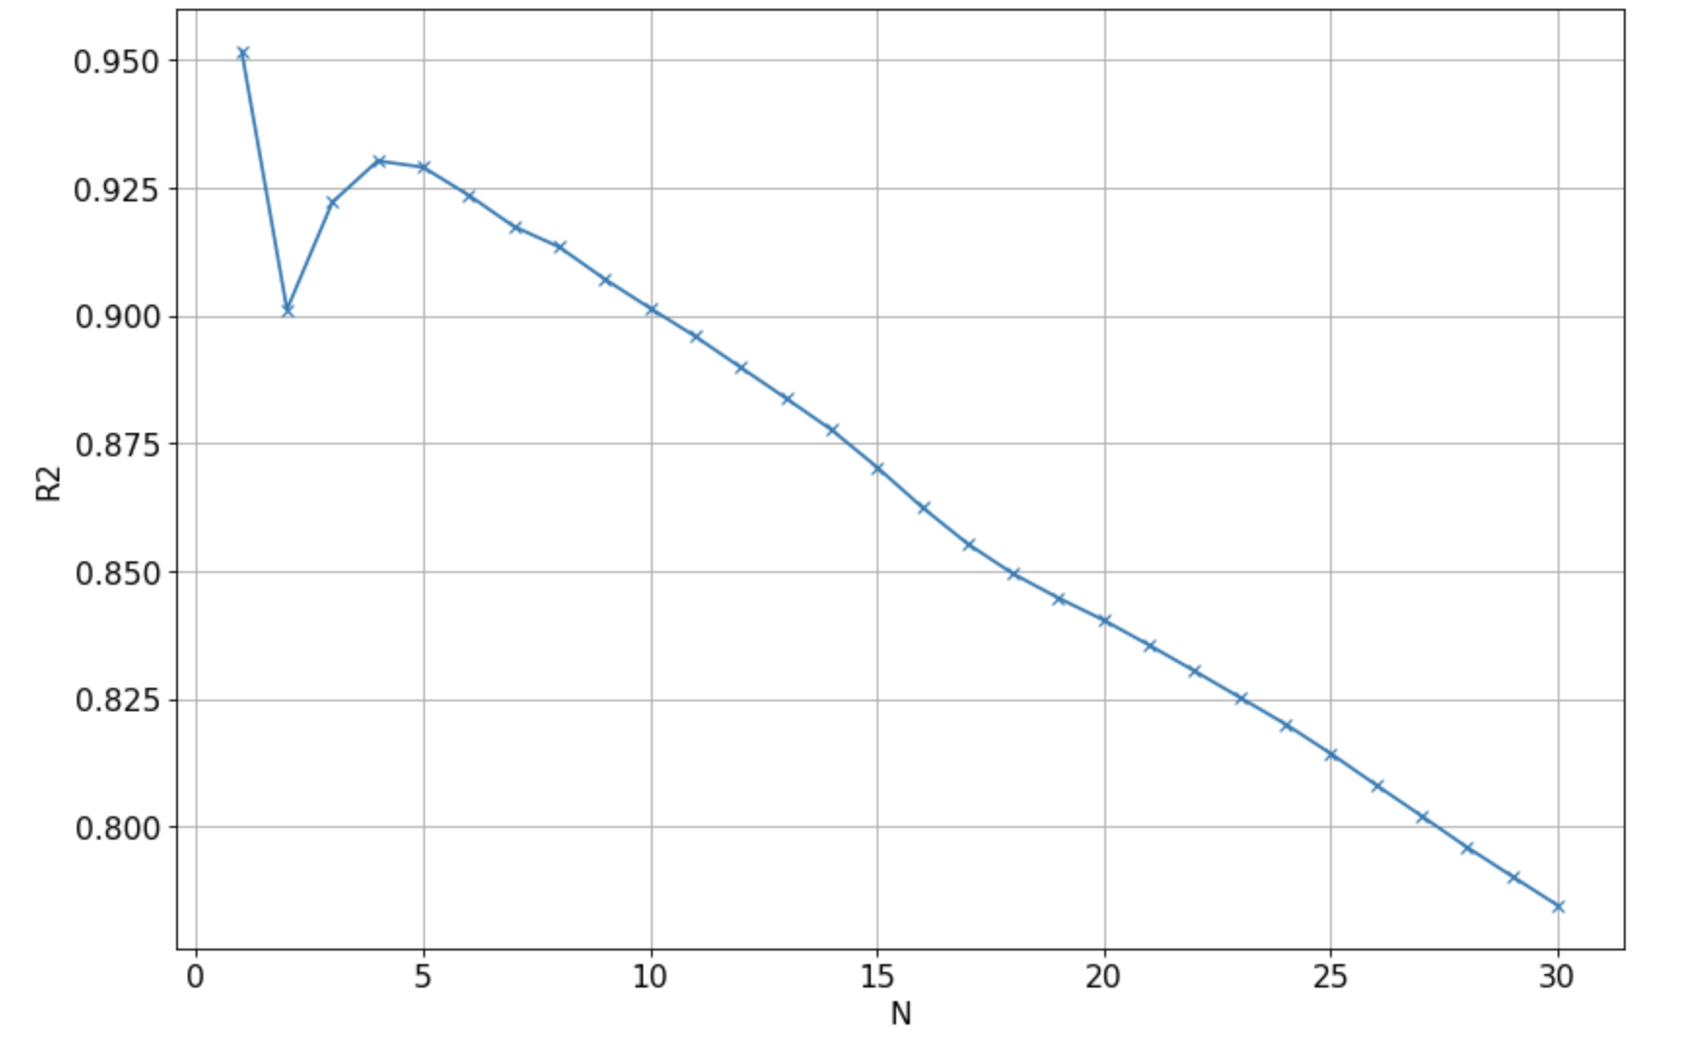
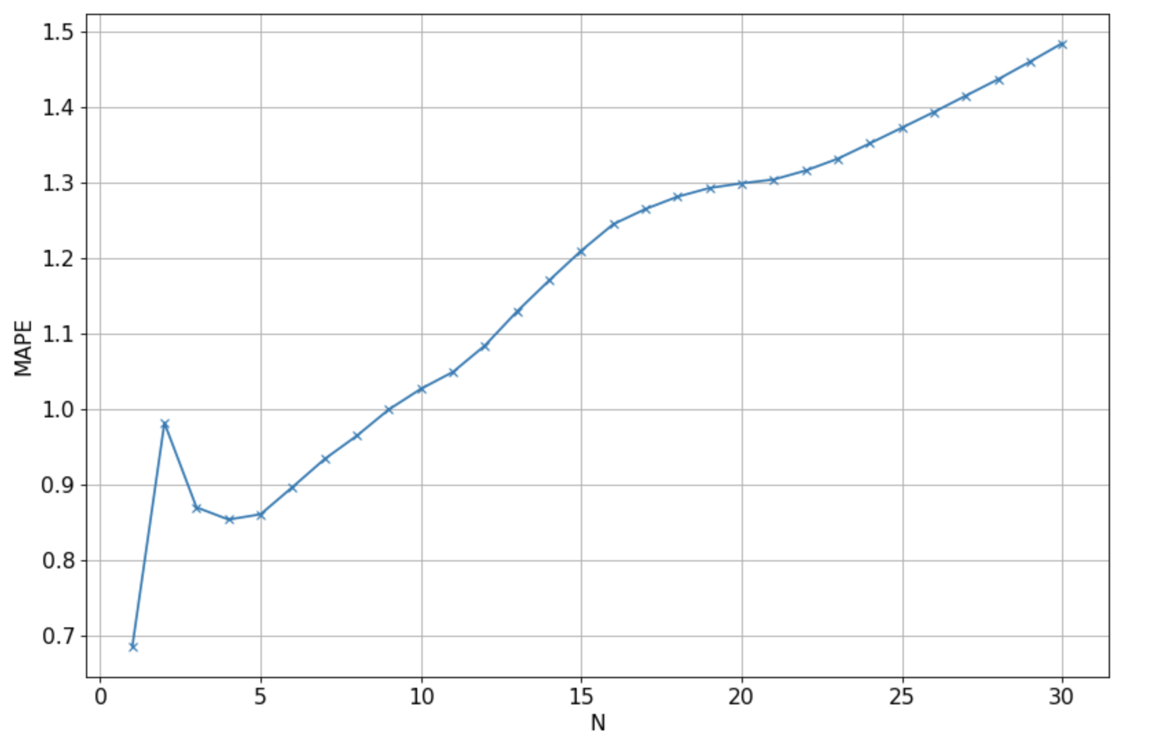


Linear Regression Method
Train
Validation
Test
715 days
440days
104days
Trained data using last N days price to predict N+1 day
1
Compare RMSE with different N
2
Compare $R^{2}$ with different N
3
Compare MAPE with different N
Through the chart, we can see Roughly the optimum N is 4, The lowest RMSE, MAPE and the highest R2 are achieved with N=1, followed by N=4. Hence, we picked N=4 for the final model

Slide 8
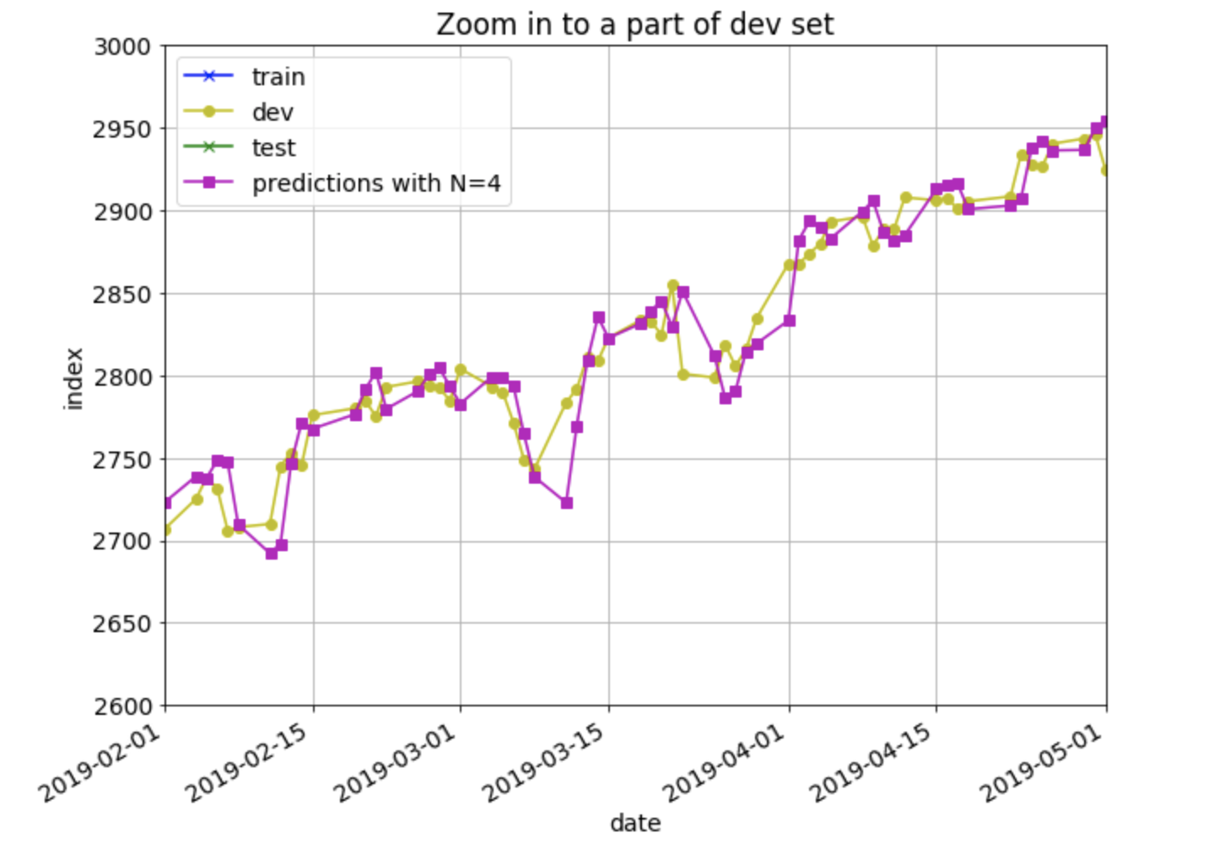
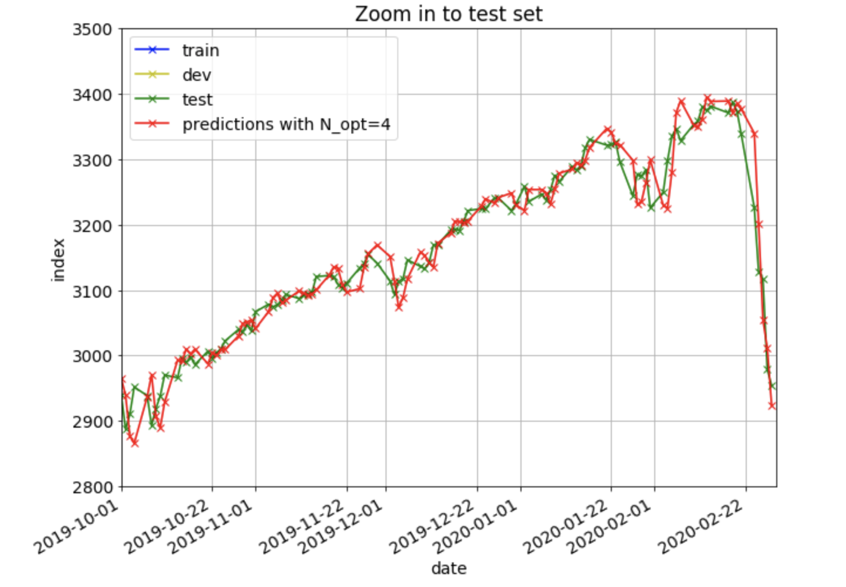
Linear Regression Method Result
Trained data using last N=4 days price to predict N+1 day
Prediction on Validation Data Set is Showed as Below
Prediction on Test Data Set is Showed as Below

Slide 9
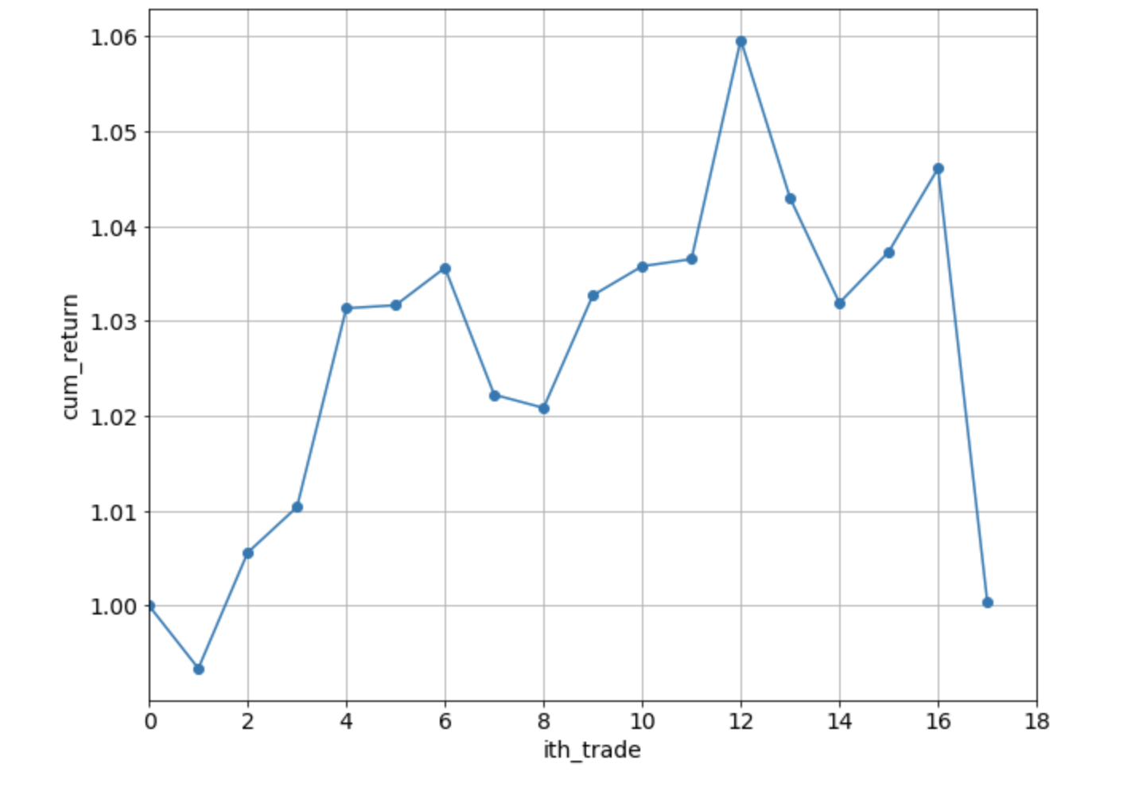
Linear Regression Trading Strategy
Buy when the model predicts a rise in the index and sell when it predicts a fall. Suppose there is no short for our trading
The Plot of Cumulative Return is Show as Below
The algorithm has a win rate of 64.7%. It shows that the trading principle’s win rate is acceptable, but the cum_return doesn’t have a good performance

Slide 10
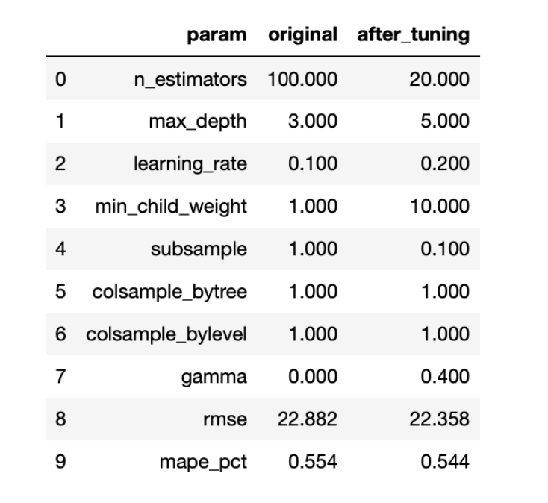
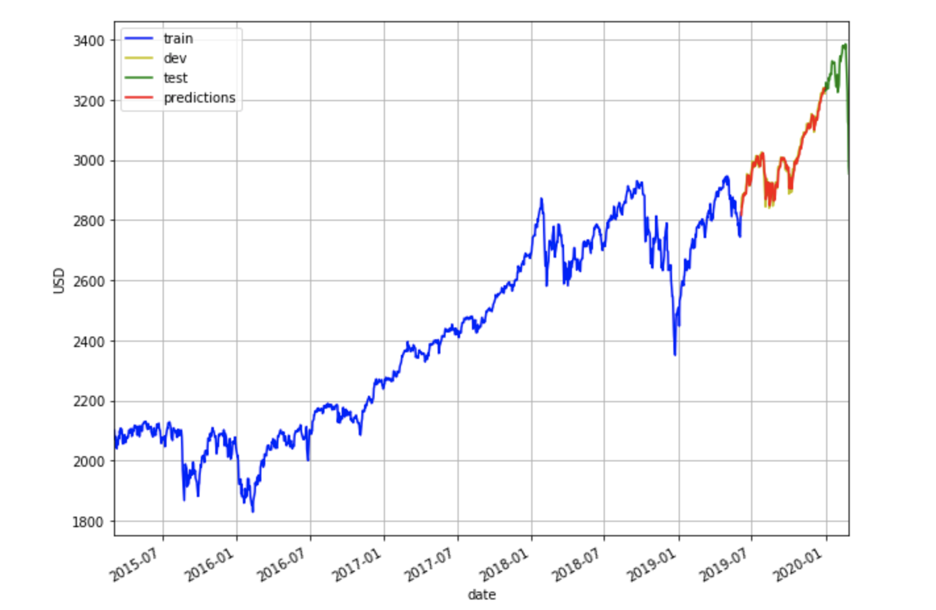
XGBOOST Method
Train
Test
Validation
Test
1071 days
1215days
41days
Scale the Feature then Fit Train Data into Model
Tuning Parameter to Optimize RMSE & MAPE
Prediction on Validation Data Set is Showed as Below
RMSE on dev set = 22.882 MAPE on dev set = 0.554%
RMSE drops from 22.882 to 22.358

Slide 11
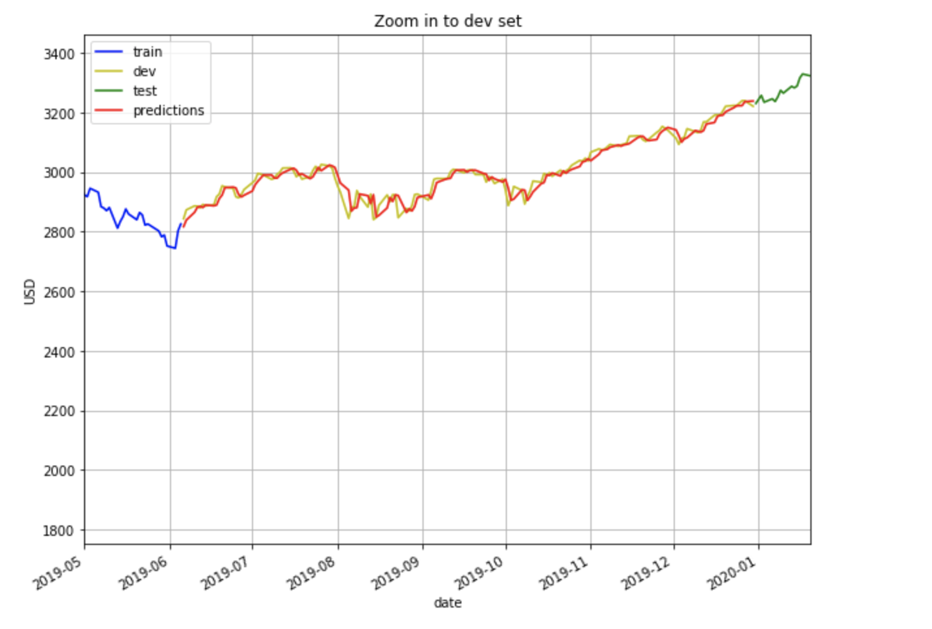
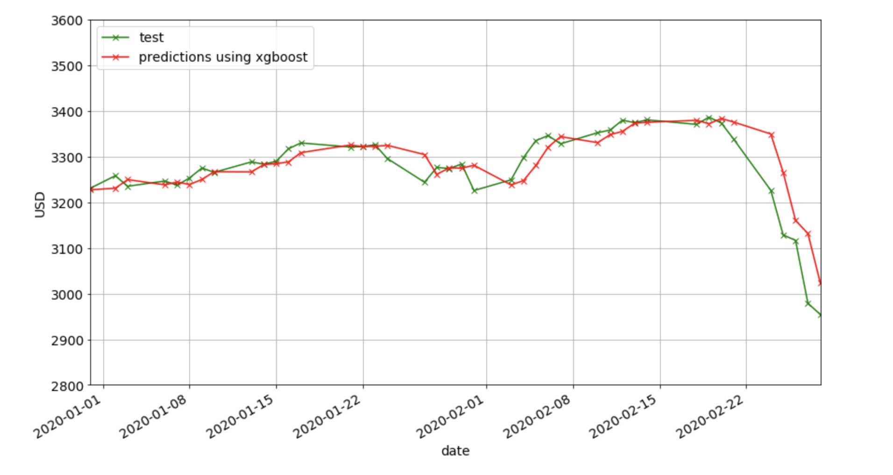
XGBOOST Performance
The Result Applying on Validation Data Set
The Result Applying on Test Data Set

Slide 12
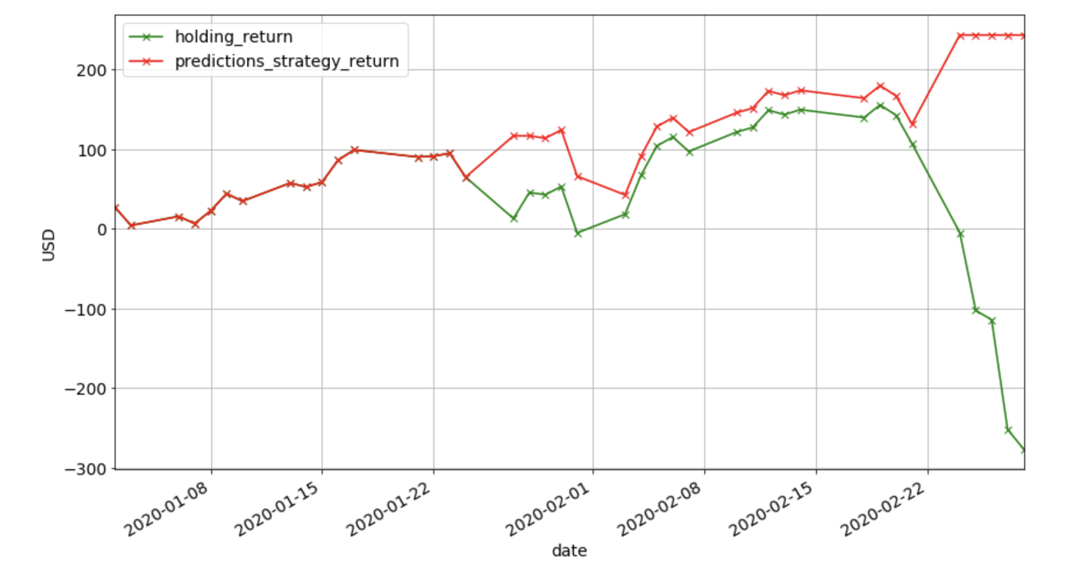
XGBOOST Trading Strategy on Prediction Result
State 1 (buy): if prediction price tomorrow is higher than today actual price within the range 10
State 2: (sell): if prediction price tomorrow is lower than today actual price within the range 10
From our return results, we notice that, with the accurate prediction result, we can prevent loss when the price is dramatically decreasing

Slide 13
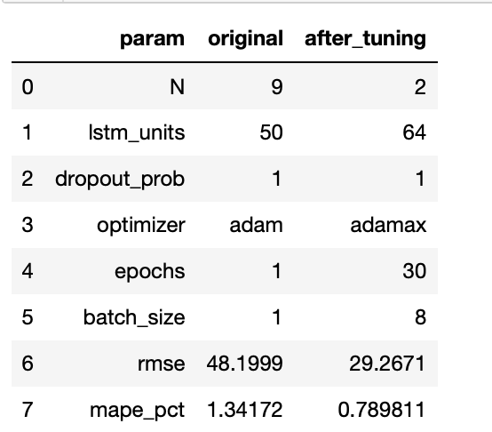
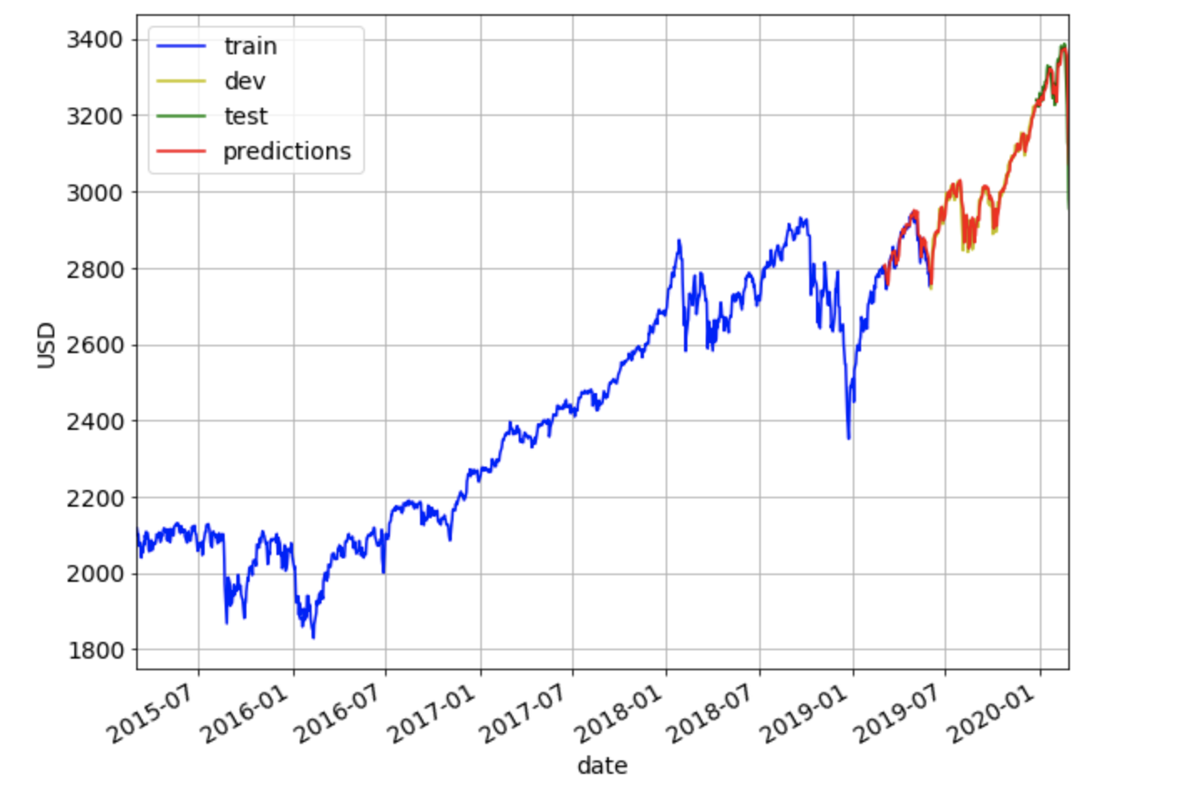
Long Short Term Memory Method
Train
Validation
Test
1071 days
1215days
41days
Scale the Feature then Fit Train Data into Model
Tuning Parameter to Optimize RMSE & MAPE
Prediction on Validation Data Set is Showed as Below
RMSE on dev set = 48.200 MAPE on dev set = 1.342%
RMSE drops from 48.200 to 29.2671

Slide 14
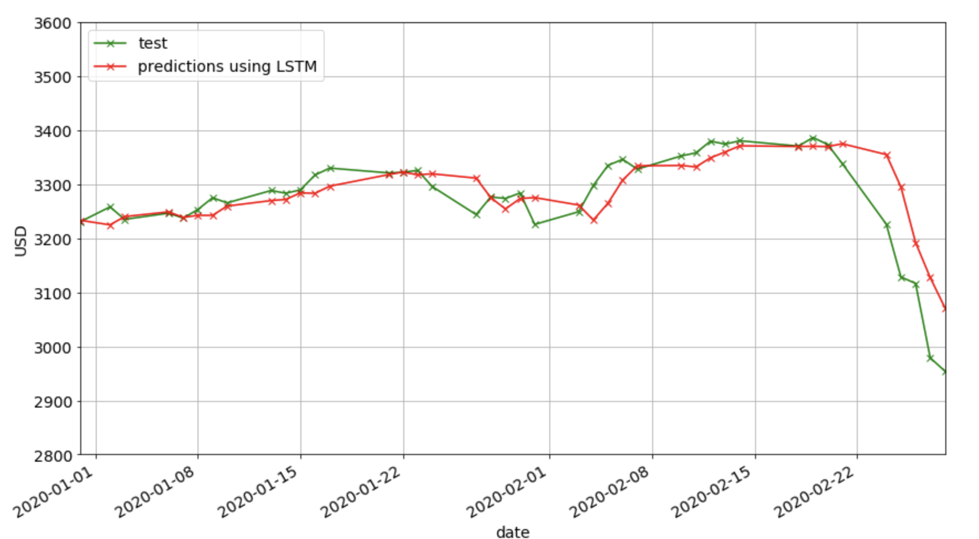
LSTM Performances
The Result Applying on Test Data Set

Slide 15
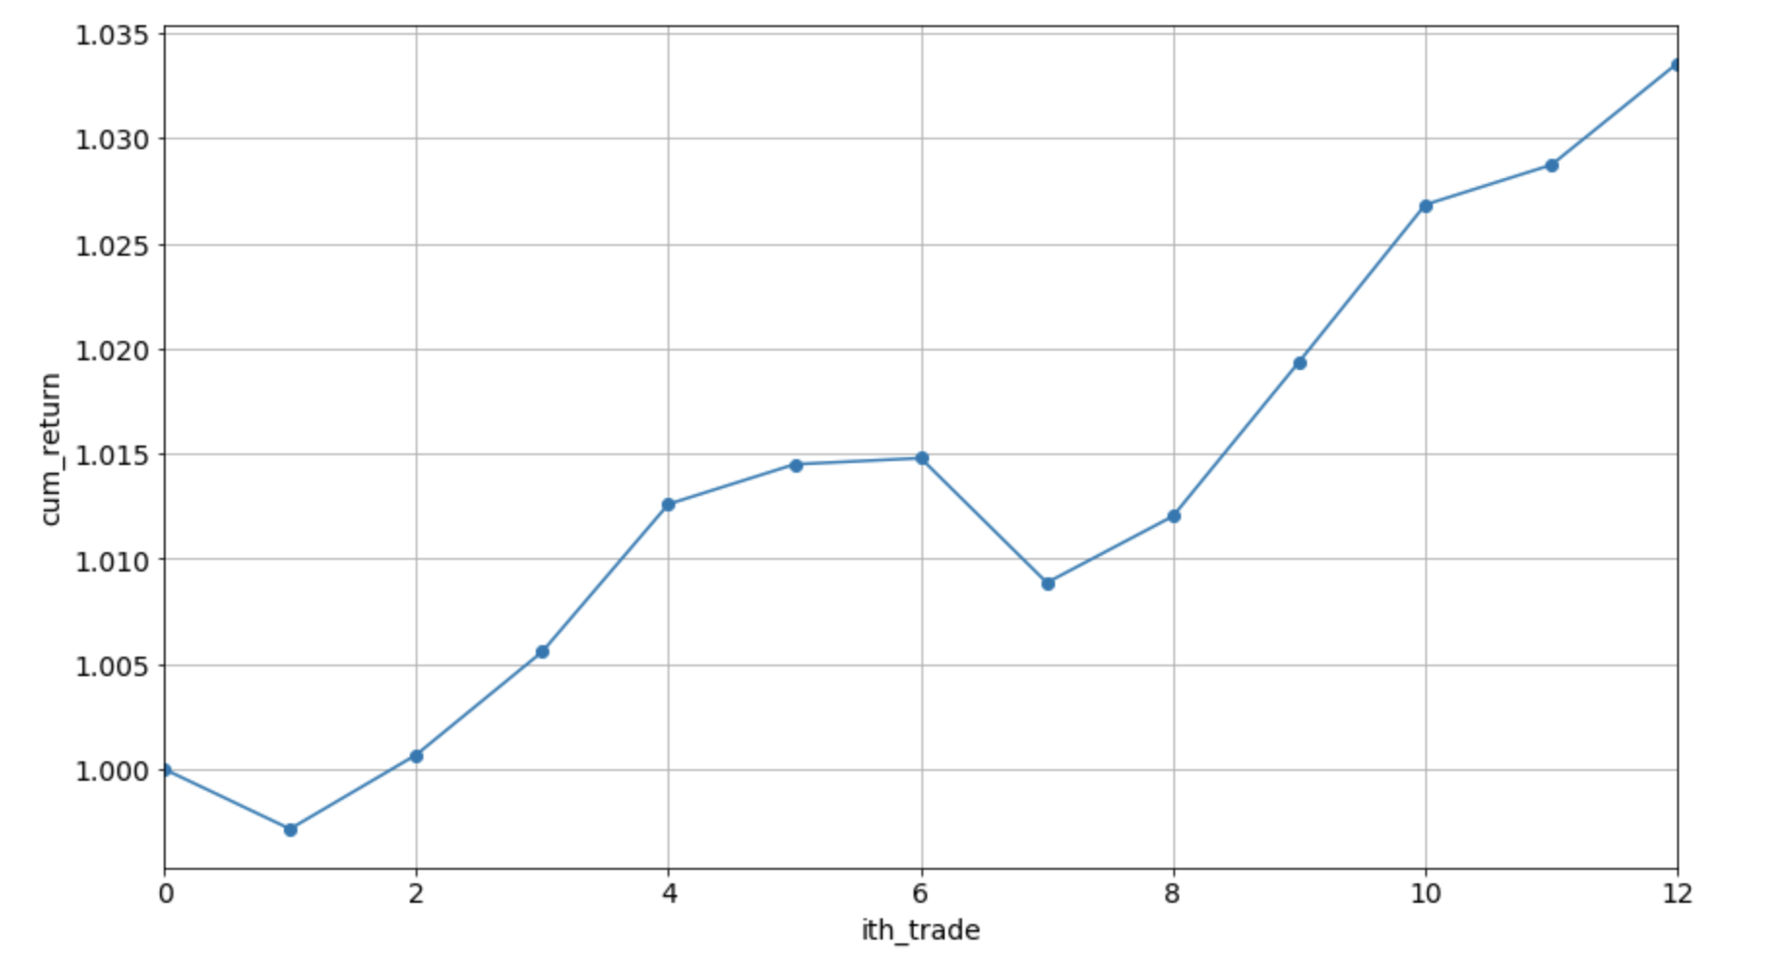
LSTM Trading Strategy
Buy when the price that LSTM predict is greater than 1.014 * adj_close price
Sell when the price that LSTM predict is less than 1.014 * adj_close price¶

Slide 16
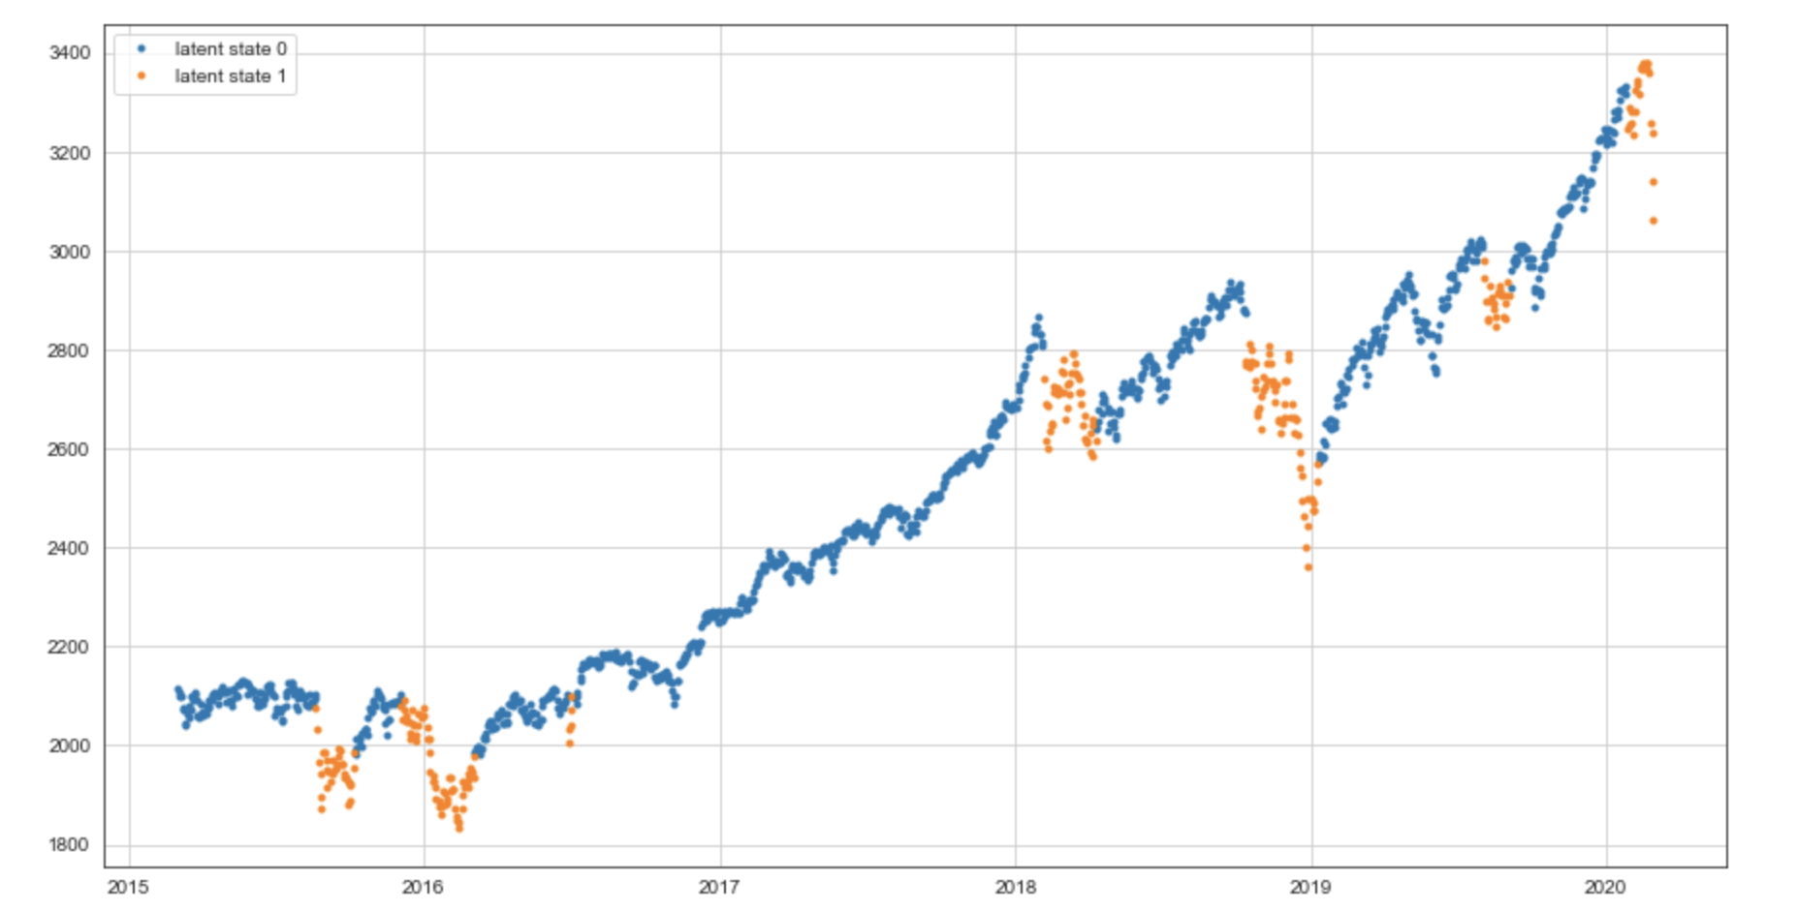
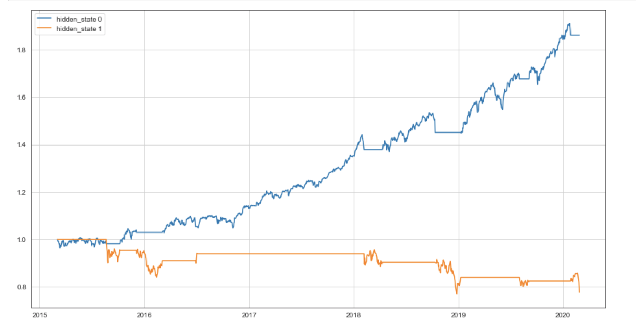
Hidden Markov Model Method
Find hidden state (patterns) based on the historical and today’s S&P 500 stock price

Slide 17
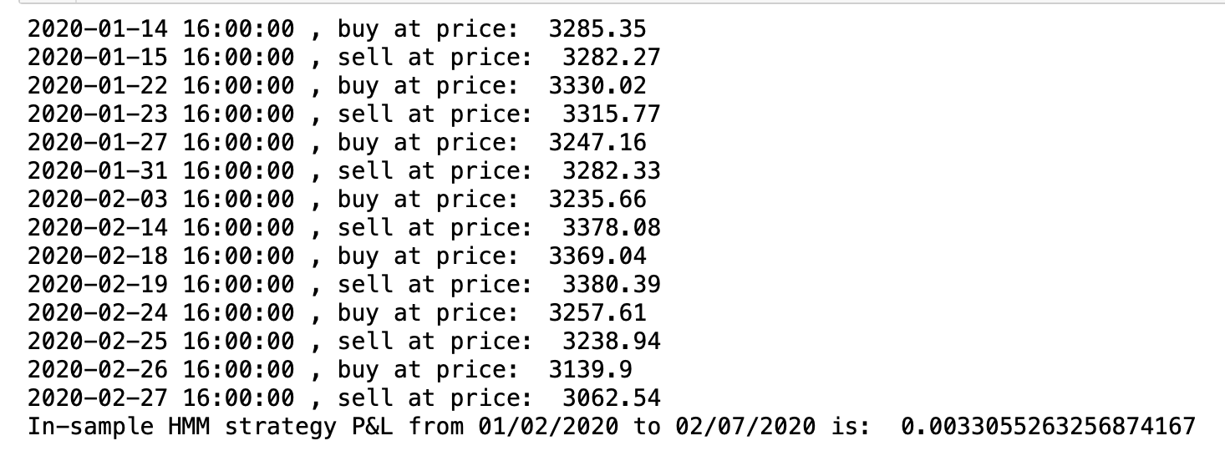
Hidden Markov Model Trading Strategy
If predicted state is bull, we buy at full position; If predicted state is bear, we sell at close position

